Slide 1


FINANCE PRESENTATION
Executive Summary – Finance Dashboard
Overview of Profit and Sales Performance (2013–2014)
By Aman Sharma

Slide 2



Dashboard Overview
The dashboard provides financial insights through visualizations.
Covers profit trends, geographic performance, and sales breakdowns.
Timeframe: 2013–2014 (monthly and quarterly views).

Slide 3
Shows profit trends over time.
Profit Trend Overview
Chart: Line Chart – Sum of Profit by Year, Quarter, and Month
Expenses
Shows profit trend over time
Peak Profit observes in late 2014
This slide presents a line chart illustrating the sum of profit over time, segmented by year, quarter, and month. It highlights noticeable fluctuations in profit throughout 2013 and 2014, with a significant peak observed in December 2014.

Slide 4

Key Profit Insights
Highest profit December 2014 (2.0m+).
Lowest profit dip below 1.0 m during mid year months.
Posiible seasonal or operational factor influencing.

Slide 5


Geographic Profit Distribution
Profit data segmented by region:
North America shows strongest performance.
Europe also contributes but at a lower level.
Useful for regional strategy planning.

Slide 6
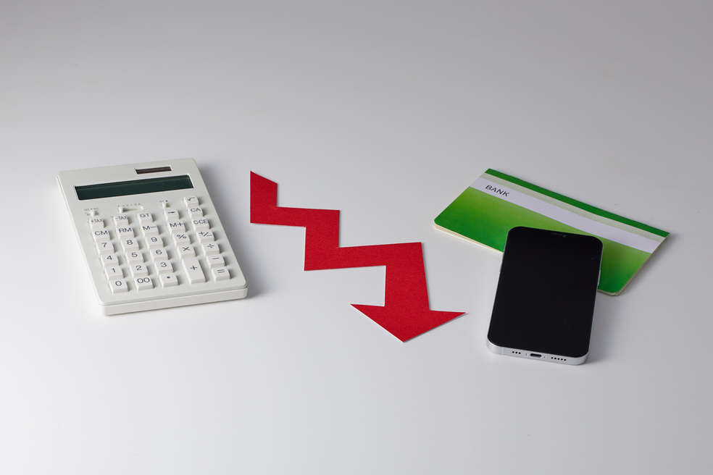


Sales by Product & Segment Overview
Products: Paseo, VTT, Velo, Amarilla, Carretera
Segments: Channel Partners, Enterprise, Government, Midmarket, Small Business

Slide 7

Segment-Wise Sales Insights
Midmarket segment leads in sales for most products.
Enterprises and small business follow
Product “paseo” is top performing across segment

Slide 8

Recommendations
Focus on high performance months and regions (eg: dec 2014 , north america).
Allocate resources to midmarket segment and paseo product.
Investigate dips for improvement oppurtunities.

Slide 9


Conclusion
Dashboard reveals strong year end performance and regional services.
Segmentation analysis highlights key revenue drivers.
Enables data driven strategic decisions for upcoming periods.
www.reallygreatsite.com

Slide 10
THANK YOU
Financial basics to make smarter money decisions and build a secure future.

